Slide 1
Design Patterns

Slide 2
Why design patterns
Generalize common scenarios
Helpful in understanding frameworks
Hopefully to do good design***
Generalization means less things to remember**

Slide 3
Design patterns.
Commonly recognized and understood solution to a problem
Example how to do event handling.
How to do pre and post processing of requests.
How to create an object without exposing the underlying class.
Gives some standardized vocabulary to talk about design to some extent… Observer design pattern, most people will understand what it means..

Slide 4
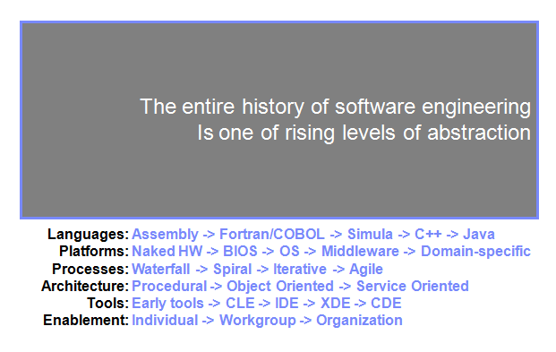

Slide 5
Abstraction in project
Project
Framework
Design patterns
Object Orientedness
Programming Language
Higher level of abstractions

Slide 6
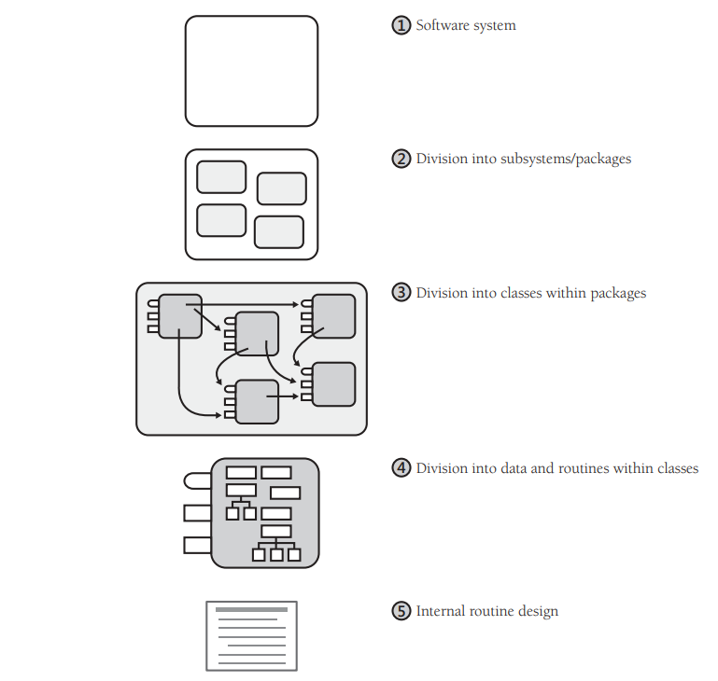

Slide 7
Architecture
Layering
How will layers communicate
Consistency…

Slide 8
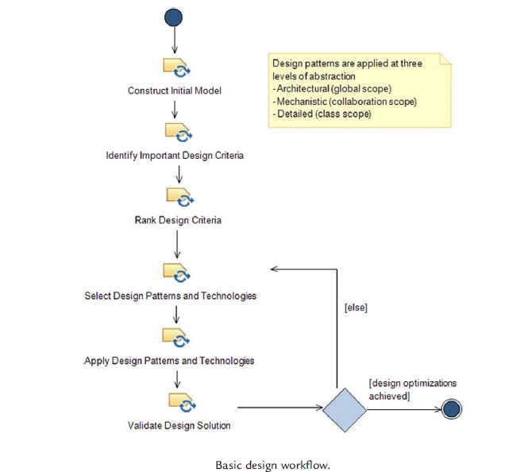
Iterate

Slide 9
Let us look at some examples
We are handling some clicking of the button
We are handlng some protocol event like http mode of request..
We are handlng some trigger
All this things look unique. But if we know that these are “Event handling scenarios” we can realize there are patterns to apply this. Once such pattern is Observer Design Pattern

Slide 10
Event
Event Source
Some variable needs to change ( state change)
Mechanism to register or unregister
Notification mechanism
Event listener
Need to agree to conditions of event source forced to define a function
Register with event source
Gets notified when event occurs.

Slide 11
design pattern general approach
What it does
When to use

Slide 12
Observer Design pattern
What it does
Let one or more objects be notified of state changes in other objects within the system.
When to use
Event handling
Look at the example in a01observer.cpp

Slide 13
Factory Design pattern
What it does
Provide an interface that delegates creation calls to one or more concrete classes in order to deliver specific objects
When to use
Example we have IPAddress4 or IPAddress6 we don’t user to bother about this, so we can provide a factory method which returns the appropriate object let us look at an example a04factory.cpp

Slide 14
Proxy Design pattern
What it does
A proxy, in its most general form, is a class functioning as an interface to something else.
We are thinking X is doing the job, but it is not X, it is something else which is doing it. Hence X can be called as proxy.
Let us look at example a02proxypattern.cpp

Slide 15
Design pattern categorization
Creational Patterns , this deals with creation of object, for example in case Factory and ther are other variations in Factory like AbstractFactory … singleton
Structural Pattern
Proxy
Template
Behavioral pattern
Observer, Strategy..
There could be other categorizations like interface and implementation patterns.

Slide 16
Things to consider
Design != knowing rules
Design is not deterministic.
No point in trying to understand design patterns if we don’t know object oriented concepts like interface, class, aggregation, composition, inheritance, we hopefully know solid principles
Try to identify design patterns in existing code and libraries and then try to think how to implement in new design.

Slide 17
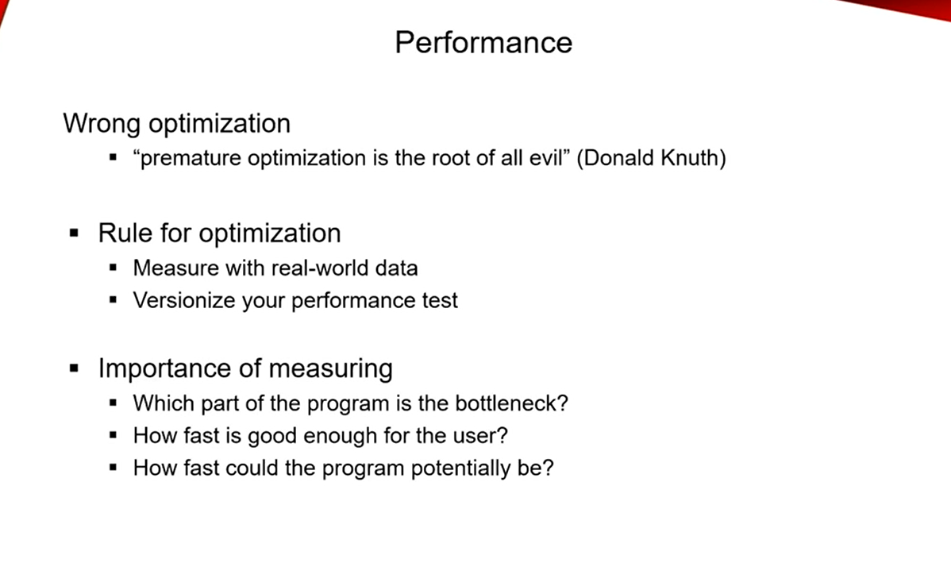

Slide 18
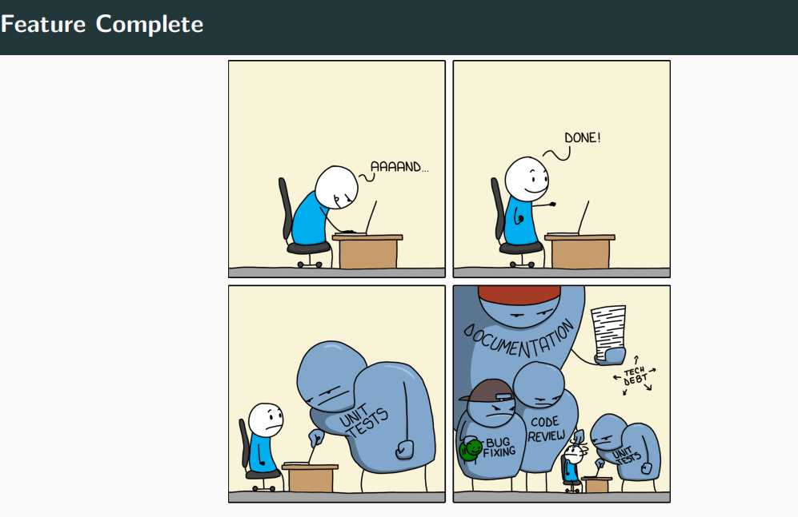
Real Life?

Slide 19
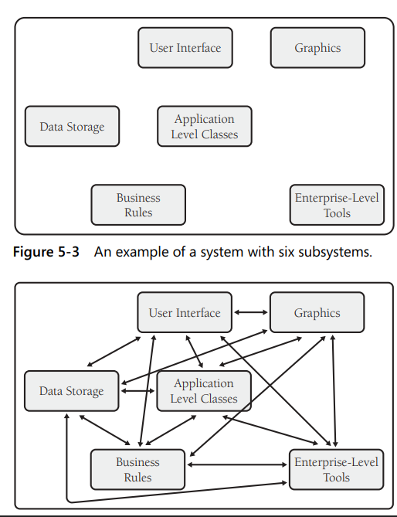
How will Design patterns help?

Slide 20
Thank you
https://github.com/noteonbg/LennoxDesignPatterns.git

